Slide 1
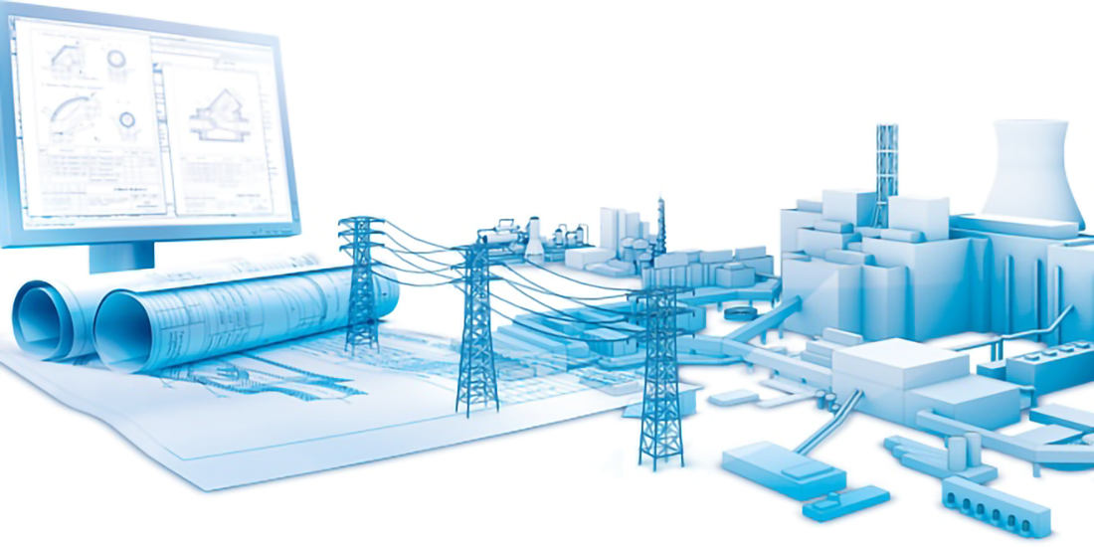


INVESTMENT DESIGN INNOVATION IN THE ENERGY SYSTEM
STATE HIGHER PROFESSIONAL EDUCATION
BELARUSIAN-RUSSIAN UNIVERSITY
DEPARTMENT
ELECTRIC DRIVE AND AUTOMATION
OF INDUSTRIAL INSTALLATIONS
course for undergraduates of the II stage of higher education specialty 1-43.80.01 "Electricity and Electrical Engineering" full-time and part-time studies
Mogilev
2021

Slide 2
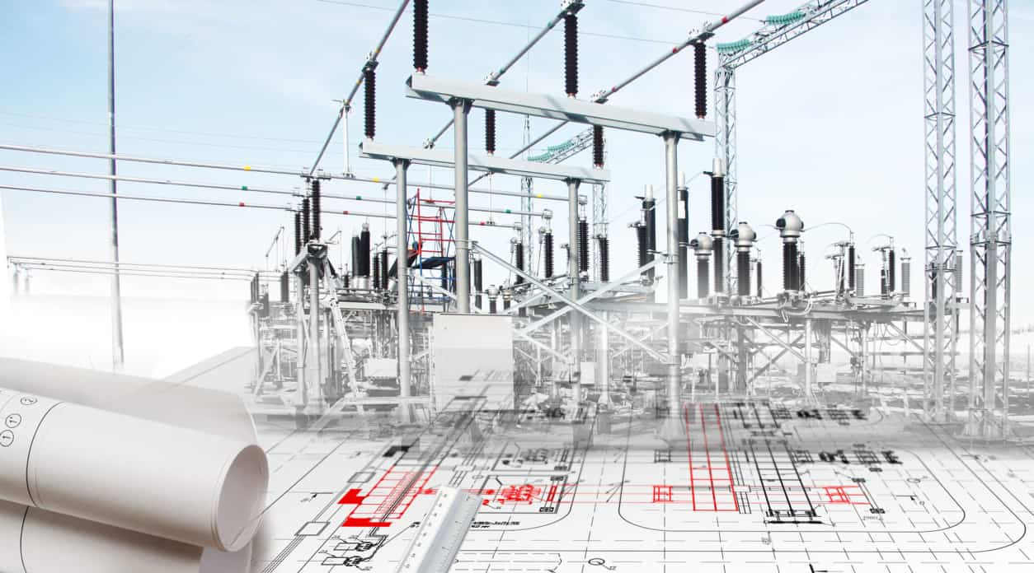
INVESTMENT DESIGN INNOVATION IN THE ENERGY SYSTEM
ENERGY INVESTMENT OBJECTS
Topic 12. TRADITIONAL ENERGY.
12.1. Basic definitions and terminology
12.2. Production of electric energy. TPP and CHPP
12.3. Hydroelectric power plants, Hydraulic accumulators
12.4 Gas turbine installations
12.5. Voltage regulation
12.6. Accounting of electric and thermal energy. Instrument accounting.

Slide 3
INVESTMENT DESIGN INNOVATION IN THE ENERGY SYSTEM
12. 1. BASIC DEFINITIONS AND TERMINOLOGY
Energy – the field of social production, covering energy resources, generation, transformation, transmission and use of various types of energy. The energy sector of each state operates within the framework of the established corresponding energy systems.
Energy system – a set of energy resources of all types, methods and means of obtaining, converting, distributing and using them, which ensure the supply of consumers with all types of energy.
Energy saving is an organizational, scientific, practical, informational activity aimed at the effective use of energy resources in the process of their extraction, processing, transportation, storage, production, use and disposal) and implemented using technical, economic and legal methods
Energy saving is a process in which the need for energy resources and energy carriers is reduced per unit of the final useful effect of the application.
Effective use of energy – the achievement of an economically and socially justified reduction in the use of energy resources per unit of production or services at the current level of development of technology and technology and in compliance with the requirements for environmental protection.

Slide 4
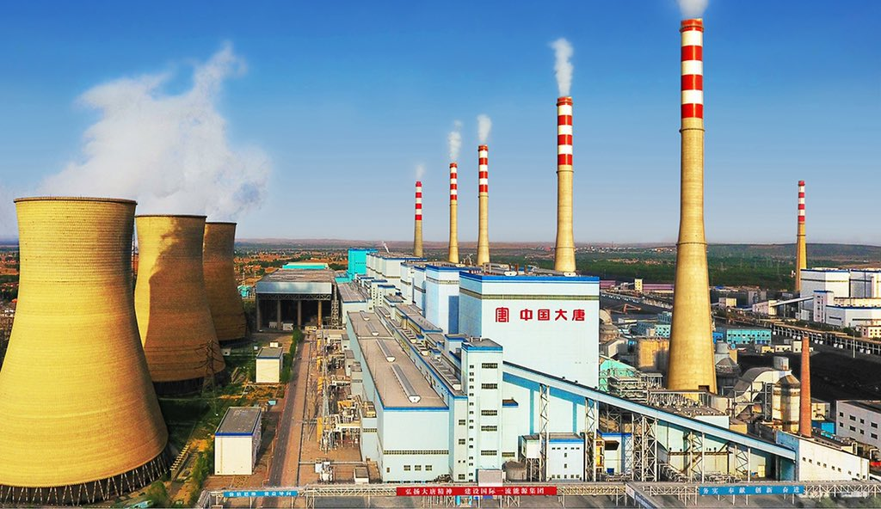
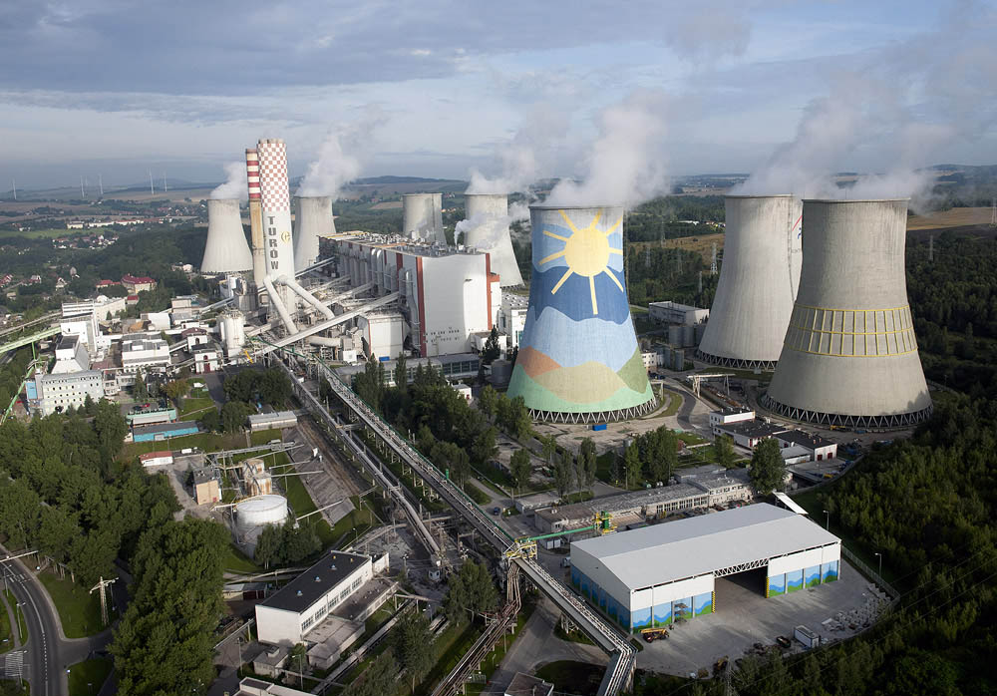
INVESTMENT DESIGN INNOVATION IN THE ENERGY SYSTEM
15.2. PRODUCTION OF ELECTRIC ENERGY. TPP AND CHPP
*Thermal Power Plant/ Thermal Station (TPP/TPS),
*Combined Heat and Power Plant / Combined Heat and Power Station (CHPP/CHPS)

Slide 5


Energy investment objects
Topic 12. Traditional energy.
INVESTMENT DESIGN INNOVATION IN
THE ENERGY SYSTEM
In traditional energy, heat is used to generate electricity, which is initially converted into mechanical work, and then into electrical energy. The efficiency of thermal machines is characterized by efficiency:
– Efficiency of the electric part of the power station (generator efficiency),
– Efficiency of the thermal part of the power station (turbine efficiency),
– Efficiency of other power plant equipment (transformers, reactors),
– Power ( , kW) generated by the generator
(group of generators),
– Total of the electric generator, kW (or a group of generators).
– Input temperature of the steam turbine,
– Output temperature of the steam turbine
Total efficiency of a thermal power station

Slide 6
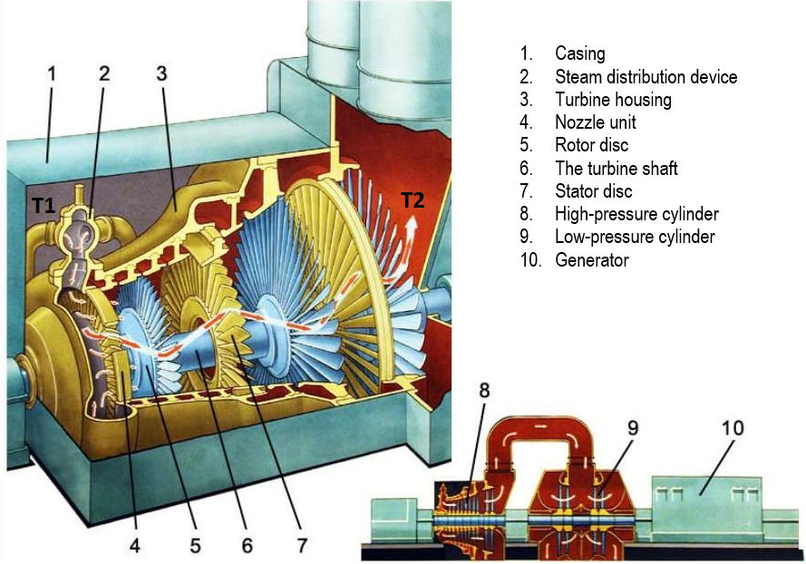
Energy investment objects
Topic 12. Traditional energy.
INVESTMENT DESIGN INNOVATION IN
THE ENERGY SYSTEM

Slide 7
Energy investment objects
Topic 12. Traditional energy.
INVESTMENT DESIGN INNOVATION IN
THE ENERGY SYSTEM
Types of power stations
The conversion of primary energy into secondary energy, in particular into electrical energy, is carried out at stations that contain in their names indications of what type of primary energy is converted into what type of secondary energy.
Depending on the type of primary engine and the method of converting various types of energy, electric power stations are divided into thermal and hydraulic.
Thermal power plants, in turn, are divided into stations with steam turbines, internal combustion engines, and gas turbines.
Currently, the most common are thermal power plants with steam turbines. Stations with gas turbines usually have a small capacity and are used in localities and industrial areas. enterprises that do not receive electricity from the power system. Currently, to increase the efficiency of fuel use, gas turbine units are installed at the CHPP, which are used to generate electric energy during peak hours.
Coal, peat, gas, oil shale, and fuel oil can serve as fuel for such a power plant. Thermal power plants are divided into condensing (СES), designed to generate only electric energy, and thermal power plants (CHP), which produce heat energy in the form of hot water and steam in addition to electric energy.

Slide 8
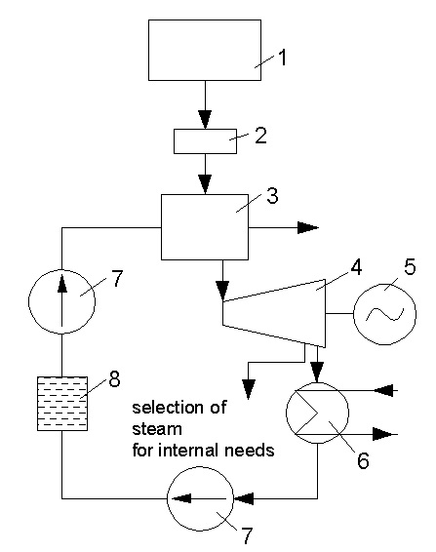
Energy investment objects
Topic 12. Traditional energy.
INVESTMENT DESIGN INNOVATION IN
THE ENERGY SYSTEM
The simplest schematic diagram of a CES operating on coal. The coal is fed to the fuel hopper 1, and from it to the crushing plant 2, where it turns into dust. Coal dust enters the furnace of a steam generator (steam boiler) 3, which has a system of pipes in which chemically purified water, called feed water, circulates. In the boiler, the water is heated, evaporated, and the resulting saturated steam is brought to a temperature of 400-650°C and at a pressure of 3-24 MPa enters the steam pipeline into the steam turbine 4. The steam parameters depend on the power of the units.

Slide 9
Energy investment objects
Topic 12. Traditional energy.
INVESTMENT DESIGN INNOVATION IN
THE ENERGY SYSTEM
Thermal condensing power plants have a low efficiency (30-40%), since most of the energy is lost with the waste flue gases and the cooling water of the condenser.
It is advantageous to build a CES in the immediate vicinity of fuel extraction sites, while electricity consumers can be located at a considerable distance from the station.
The combined heat and power plant differs from the condensing station by a special heat-generating turbine with steam extraction installed on it. At the CHPP, one part of the steam is completely used in the turbine to generate electricity in the generator 5 and then enters the condenser b, and the other, which has a high temperature and pressure, is taken from the intermediate stage of the turbine and used for its own needs. The condensate is fed to the steam generator by the pump 7 through the deaerator 8 and then by the feed pump 9. The amount of steam extracted depends on the heat energy needs of the enterprises.
The efficiency of the CHPP reaches 60-70%.
Such stations are usually built near consumers — industrial enterprises or residential areas. Most often, they work on imported fuel.

Slide 10
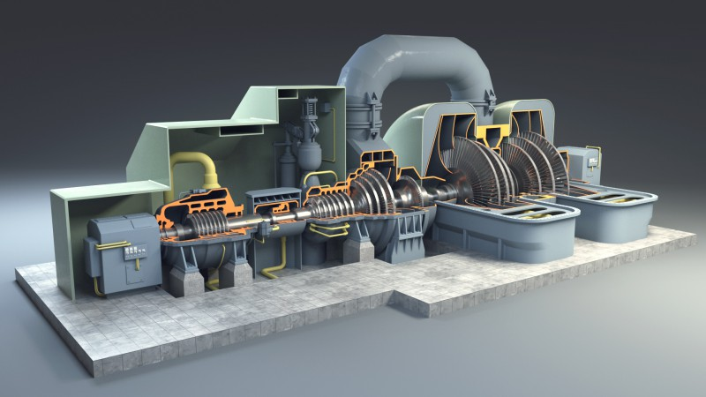
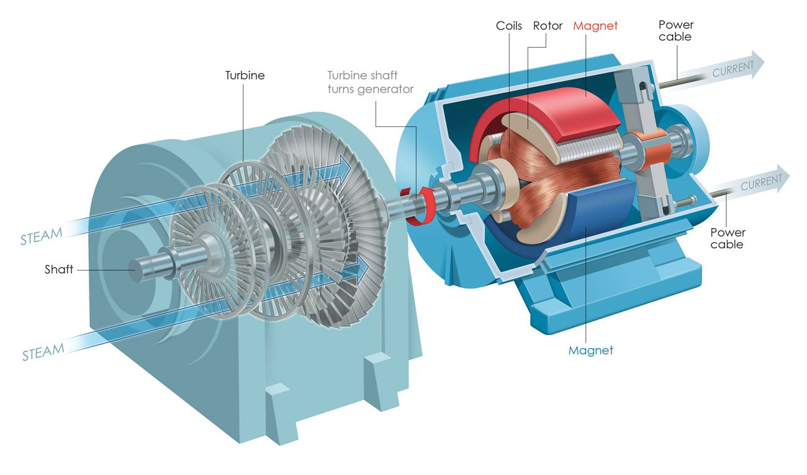
Energy investment objects
Topic 12. Traditional energy.
INVESTMENT DESIGN INNOVATION IN
THE ENERGY SYSTEM
Steam turbine in the section

Slide 11
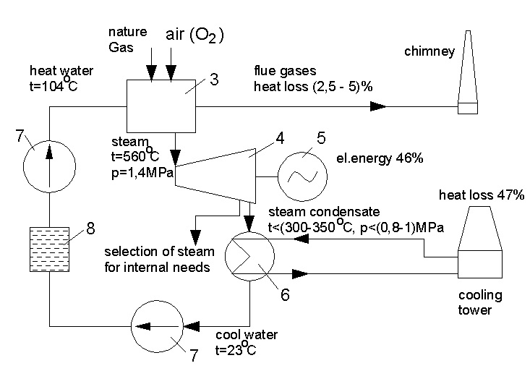
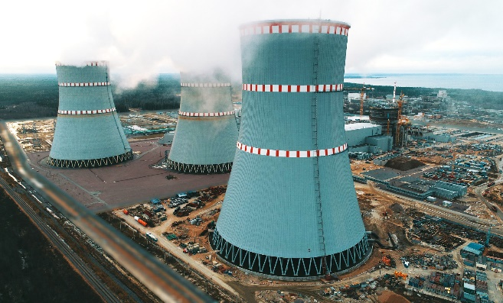
Energy investment objects
Topic 12. Traditional energy.
INVESTMENT DESIGN INNOVATION IN
THE ENERGY SYSTEM
Thermal Power Plant / Thermal Power Station (TPP/TPS)
Cooling tower

Slide 12
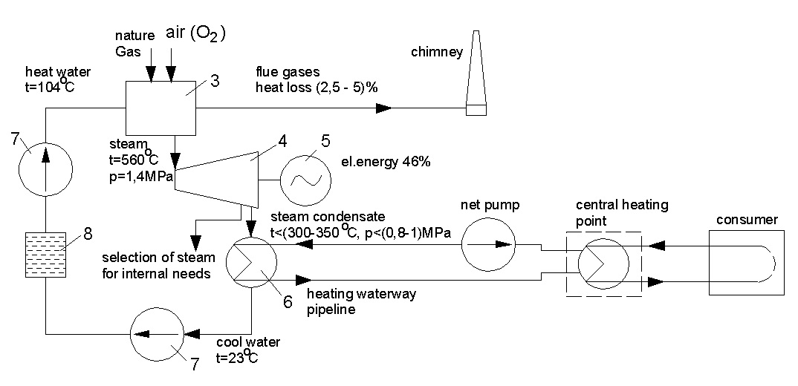
Energy investment objects
Topic 12. Traditional energy.
INVESTMENT DESIGN INNOVATION IN
THE ENERGY SYSTEM
Combined Heat and Power Plant/Combined Heat and Power Station (CHPP/CHPS)

Slide 13
INVESTMENT DESIGN INNOVATION IN THE ENERGY SYSTEM
12.3. HYDROELECTRIC POWER PLANTS (HPPs)
Hydroelectric power plants (HPPs) have significantly higher efficiency. The hydroelectric power station uses the energy of rivers. Therefore, there is no such process as the conversion of thermal energy into mechanical energy. By constructing a dam, a difference in water levels is created. Water flowing from the upper level to the lower level, either through special pipes (turbine pipeline), or through channels made in the body of the dam, acquires a greater speed. The water jet flows further to the blades of the hydraulic turbine. The rotor of the hydraulic turbine is driven by the centrifugal force of the water jet. Theoretically, the efficiency can reach 90%. The hydroelectric power station is undergoing transformations:
The mechanical energy of the water is converted into electrical energy

Slide 14
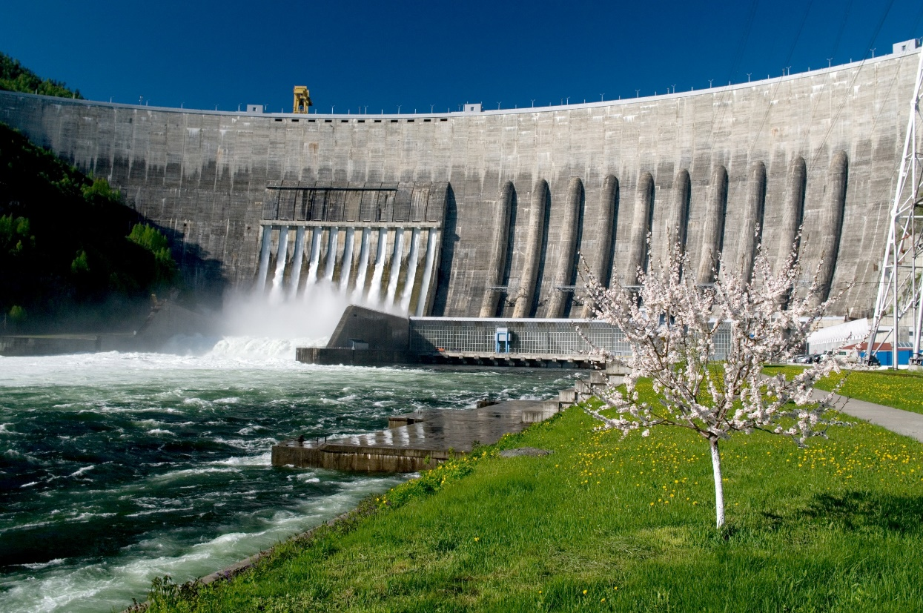
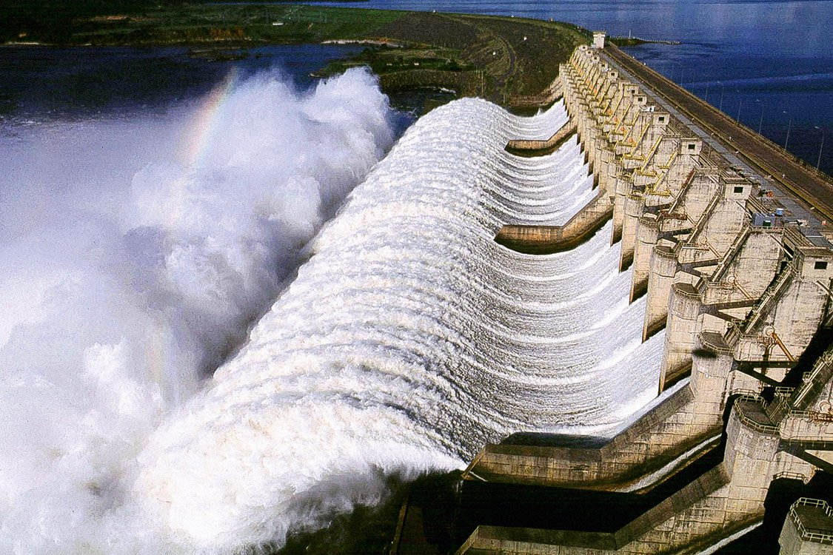
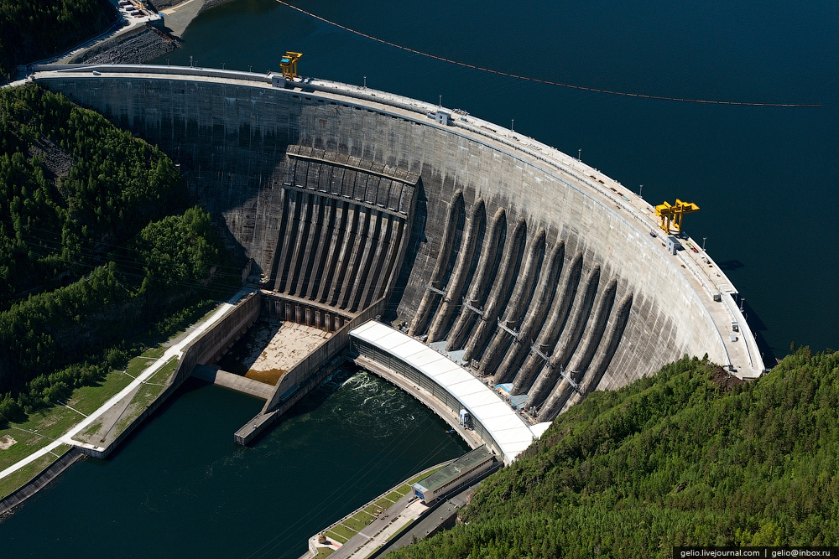
Energy investment objects
Topic 12. Traditional energy.
INVESTMENT DESIGN INNOVATION IN
THE ENERGY SYSTEM
Hydro Power Plant
Dam

Slide 15
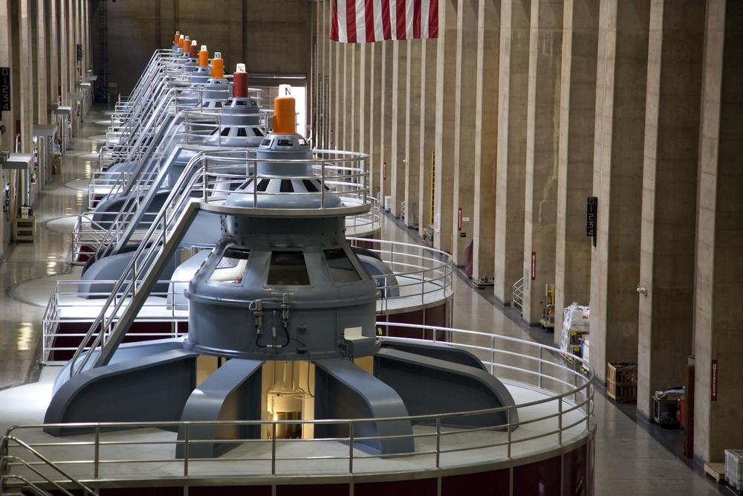
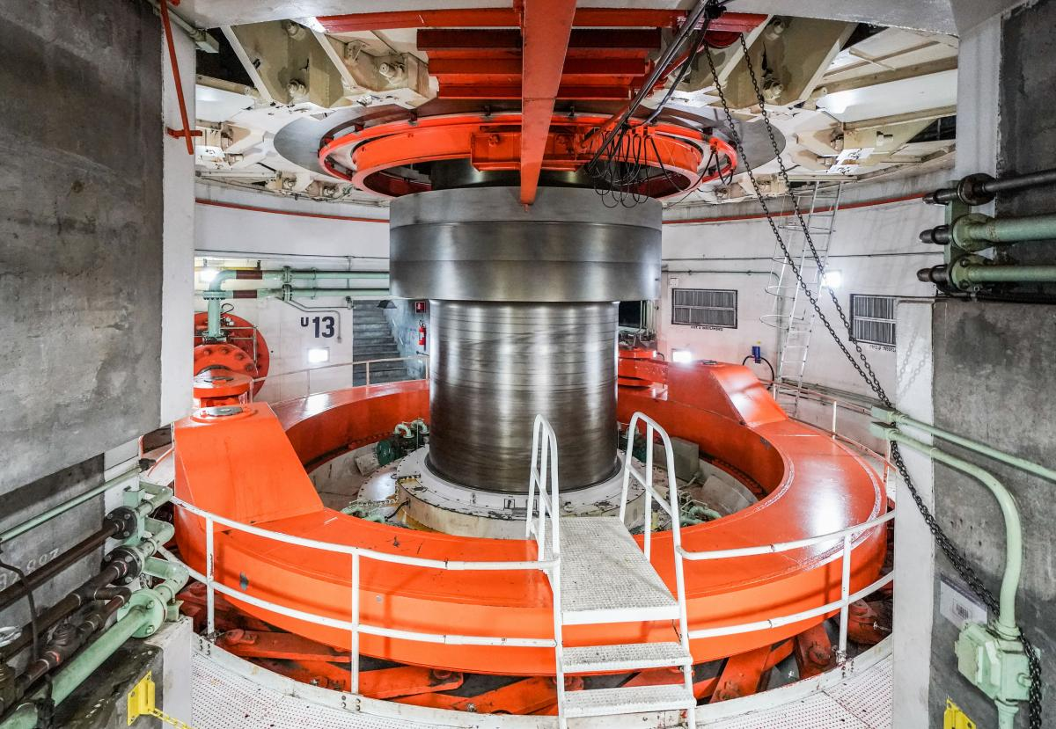
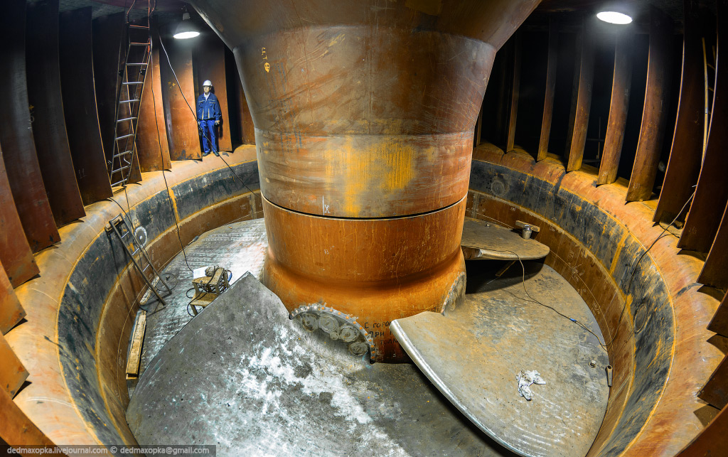
Energy investment objects
Topic 12. Traditional energy.
INVESTMENT DESIGN INNOVATION IN
THE ENERGY SYSTEM
Hydro Power Plant
Turbine hall

Slide 16
Energy investment objects
Topic 12. Traditional energy.
INVESTMENT DESIGN INNOVATION IN
THE ENERGY SYSTEM
Hydraulic accumulator power plants
The PSPP uses either a complex of generators and pumps, or reversible hydroelectric units, which are capable of operating both in the generator mode and in the pump mode. During the night failure of energy consumption, the PSPP receives cheap electricity from the power grid and spends it on pumping water to the upstream (pumping mode). During the morning and evening peaks of energy consumption, the PSPP discharges water from the upstream to the downstream, while generating expensive peak electricity, which it gives to the power grid (generator mode).
In large power systems, a large share can be made up of the capacity of thermal and nuclear power plants, which cannot quickly reduce electricity generation with a night-time reduction in energy consumption, or do so with large losses. This fact leads to the establishment of a significantly higher commercial cost of peak electricity in the power system, compared to the cost of electricity generated during the night period. In such conditions, the use of PSPS is cost-effective and increases both the efficiency of using other capacities (including transport ones) and the reliability of energy supply.
The first PSPs at the beginning of the XX century had an efficiency of no more than 40%, the efficiency of modern PSPs is 70-75%.

Slide 17
INVESTMENT DESIGN INNOVATION IN THE ENERGY SYSTEM
12.4. GAS TURBINE INSTALLATIONS
Gas turbine units (GTU) can be used at thermal power plants.
Dignities:
1. Gas turbines are more compact than steam turbines.
2. High maneuverability, start time: 1.5-2 min, easy to start, stop, adjustable.
In GTU, the working fluid is a mixture of fuel combustion products with air or heated air at high pressure and high temperature.
The efficiency of GTU with a capacity of 100 MW reaches 31-32%.
The following transformations are carried out in the GTU: The thermal energy of the gases is converted into the kinetic energy of the turbine rotor rotation, and then into electrical energy

Slide 18
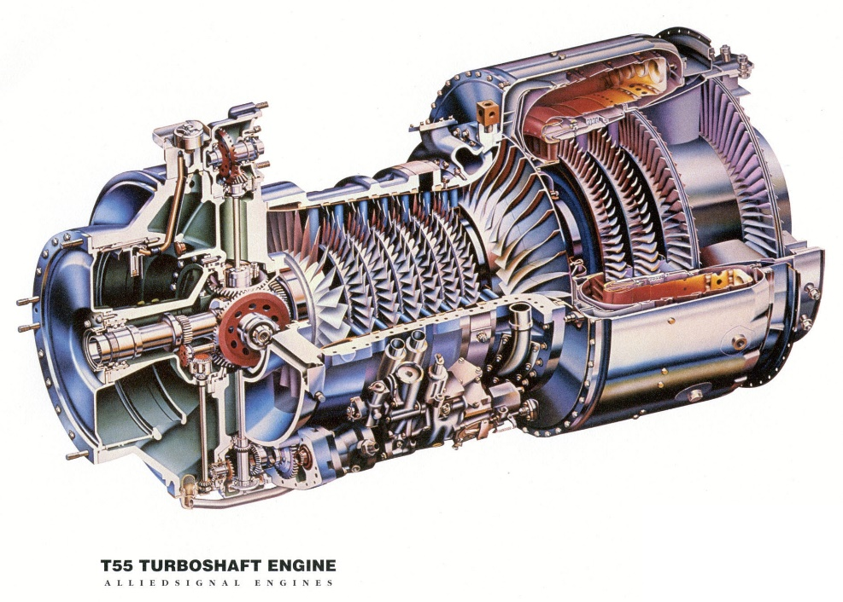
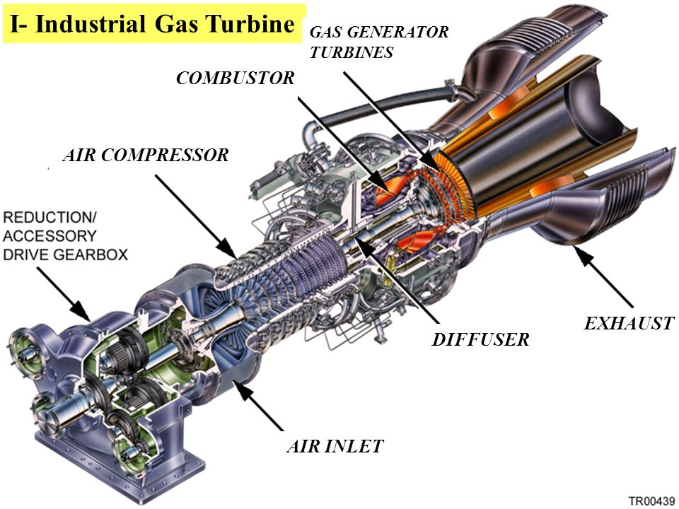
Energy investment objects
Topic 12. Traditional energy.
INVESTMENT DESIGN INNOVATION IN
THE ENERGY SYSTEM
Gas turbine module in the section

Slide 19
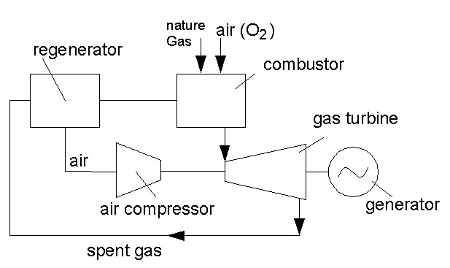
Energy investment objects
Topic 12. Traditional energy.
INVESTMENT DESIGN INNOVATION IN
THE ENERGY SYSTEM
Gas turbine units (GTU)
The combustion chamber is supplied with liquid or gaseous fuel and air. The high-pressure gases
formed in it at t-750-770C are directed to the working blades of the turbine. The turbine rotates an electric generator that generates electricity, and a compressor
that serves to supply pressurized air to the combustion chamber. The compressed air in the compressor is heated in the regenerator by the combustible gases used in the turbine before being fed to the combustion chamber. Heating the air allows you to increase the efficiency of fuel combustion in the combustion chamber.

Slide 20
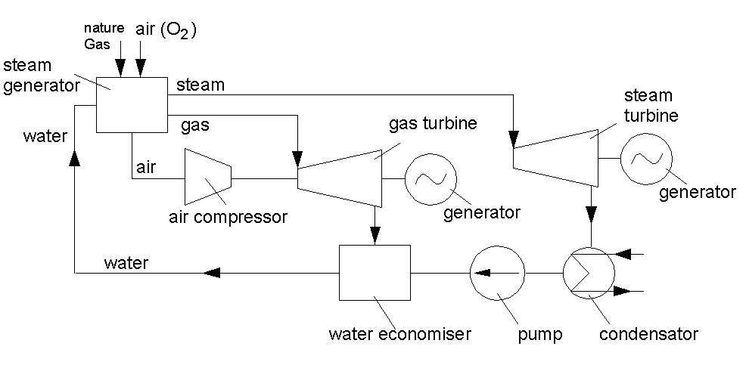
Energy investment objects
Topic 12. Traditional energy.
INVESTMENT DESIGN INNOVATION IN
THE ENERGY SYSTEM
SGU(steam-gas unit)

Slide 21
Energy investment objects
Topic 12. Traditional energy.
INVESTMENT DESIGN INNOVATION IN
THE ENERGY SYSTEM
The combined cycle gas plant is binary, because it uses two working bodies: steam and gas (gas - in the upper part of the plant, steam - in the lower).
To increase the economic efficiency of the use of GTU for thermal power plants, combined-cycle plants are used: a combination of gas turbine and steam turbine plants. The combination of gas and steam turbine units so; that is the joint use of thermal energy. Obtained by burning fuel: increases the efficiency of the installation by 81%.

Slide 22
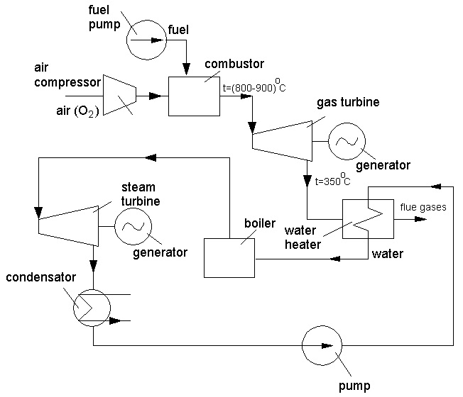
Energy investment objects
Topic 12. Traditional energy.
INVESTMENT DESIGN INNOVATION IN
THE ENERGY SYSTEM
The economizer allows the exhaust gases in the turbine to be used for heating the feed water: this reduces fuel consumption and increases efficiency by up to 44%.

Slide 23
Energy investment objects
Topic 12. Traditional energy.
INVESTMENT DESIGN INNOVATION IN
THE ENERGY SYSTEM
Air from the atmosphere enters the compressor, where it is compressed adiabatically (without heat exchange with the environment with an increase in temperature) and is fed to the combustion chamber, where fuel is injected using a pump. In the combustion chamber, at constant pressure, the fuel is gorenje; the formed gases enter the gas turbine; work is performed: the spent combustible gases enter the heater, give part of the heat to heat the feed water, which enters the boiler. Further, steam is formed in the boiler from the feed water (p=Const).

Slide 24
INVESTMENT DESIGN INNOVATION IN THE ENERGY SYSTEM
12.5. VOLTAGE REGULATION
Methods of voltage regulation in power supply systems of industrial enterprises can be classified as follows:
a) Regulation on the tires of power plants and substations
On the buses of electric stations, by changing the excitation current of the generators, they increase the voltage during the hours of maximum load and reduce the voltage during the hours of minimum load.
Regulation of the voltage on the buses of the step-down power supply of 6-10 kV can be carried out with the help of transformers, statistical capacitors, synchronous compensators.
b) Regulation on outgoing lines
Individual voltage regulation on each line extending from the p/st busbars is an effective way. In this case, transformers with LVR (load voltage regulation), ST (Surge transformer) and capacitors for longitudinal compensation can be used.

Slide 25
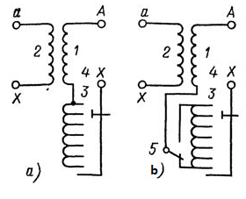
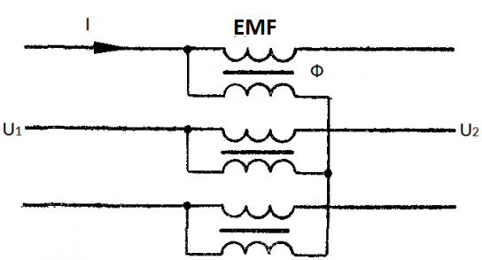
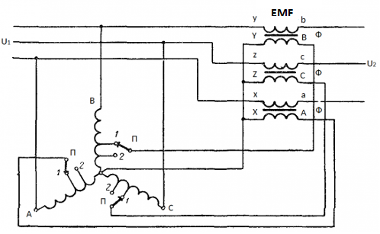
Energy investment objects
Topic 12. Traditional energy.
INVESTMENT DESIGN INNOVATION IN
THE ENERGY SYSTEM
transformer with LVR
(load voltage regulation)
transformer with ST
(Surge transformer)
Regulation scheme for transformers without reversing (a) and with reversing (b) the adjustment winding: 1, 2-the primary and secondary windings, respectively, 3-the adjustment winding, 4-the switching device, 5-the reverser
c) Joint voltage regulation includes a) and b) control methods

Slide 26
INVESTMENT DESIGN INNOVATION IN THE ENERGY SYSTEM
12.6. ACCOUNTING OF ELECTRIC AND THERMAL ENERGY. INSTRUMENT ACCOUNTING.
The main consumers of heat and electricity are industry and the housing and utilities sector.
Due to its universality, unlimited division and transformation into other types of energy, electric energy is used in various spheres of human activity, in everyday life, in industry. Since electricity is used by different receivers, the mode of electricity production during the day, month, or year will not remain constant. The schedule of electricity production and consumption is characterized by unevenness. Industrial consumers are the most energy-intensive group of electricity consumers. The share of industry in total energy consumption is more than 57%.
Automated control systems of heat supply systems. The system implies automatic regulation with the maintenance of a constant or changing according to a certain law of the physical parameter that characterizes the process (pressure, temperature). The main tasks facing the control system are stabilization (maintaining constant controlled values with a given accuracy) and program control (control of a physical parameter according to a previously known law).

Slide 27
Energy investment objects
Topic 12. Traditional energy.
INVESTMENT DESIGN INNOVATION IN
THE ENERGY SYSTEM
Depending on the method of measuring the flow rate of the coolant, there is a wide range of water heat meters:
- electromagnetic induction,
- mass, winged,
- vortex,
- ultrasonic, etc.
The automated process control system performs measurements, commercial and technological accounting of heat energy and coolant parameters in closed and open heating and hot water systems. It is used for measuring thermal energy in residential, public, municipal, industrial buildings, and can be used in automated systems for accounting and monitoring of thermal energy. The electromagnetic Microprocessor heat meter consists of a measuring and computing unit and a flow and temperature sensor. The system implements the functions of signal processing and automatic measurement from flow, pressure, and temperature sensors, monitoring the temperature difference of the coolant in the forward and reverse pipelines, accounting for the lowered heat capacity, volume and mass of the coolant, and the amount of heat consumed.

Slide 28
Energy investment objects
Topic 12. Traditional energy.
INVESTMENT DESIGN INNOVATION IN
THE ENERGY SYSTEM
With the help of regulators, the technological mode and automatic regulation are organized. The system maintains a database of current events for the period and records of accidents, which is very important when releasing heat to the consumer. The system is easily integrated into the top-level automated control system.
The modern fleet of electric meters is very diverse. They are classified according to the type of current, the number of phases, the accuracy class, the measured parameters, the number of tariffs, the element base, etc.
Modern automated control systems are multi-level networks of accounting, control, and energy consumption management with complexes of technical means of collecting, processing, presenting, and storing information, communication lines, tele-measurement, tele-information, and remote control. The functioning of the ASC is carried out in real time within the production and organizational structures of the enterprise, its energy-producing facilities, non-production facilities, as well as commercially independent structures associated with this enterprise for energy consumption.

Slide 29

Energy investment objects
Topic 12. Traditional energy.
INVESTMENT DESIGN INNOVATION IN
THE ENERGY SYSTEM
Test
TPPs
CHPPs
HPPs
GTUs
SGUs

